Slide 1
LSU Early Gas Kick Detection Tests: Quick-Look Review of Real Time Monitoring of hDVS (DAS) Data
Toba Ogunsanwo
(Sr. RE / NAL Domain Champion)
Jan 2020
Notes:
Real time latency: 26 – 31 sec

Slide 2
Day 1, Trial 1, 2, & 3 Test Events Sequence
 | Events | Date | Start time (hrs) | Stop time (hrs) | Duration (hrs) | Comments
 | LSU Test Day 1, Jan 08, 2020
1 | Trial 1
 | Achieved steady state pre-conditioning @ 300 gpm | 8-Jan-20 | 12:47 | 13:13 | 0:26
 | Reduced pump rate to 200 gpm | 8-Jan-20 | 13:13 | 13:16 | 0:03
 | Reduced pump rate to 150 gpm | 8-Jan-20 | 13:16 | 13:19 | 0:03
 | Reduced pump rate to 100 gpm | 8-Jan-20 | 13:19 | 13:22 | 0:03
 | Reduced pump rate to 55 gpm | 8-Jan-20 | 13:22 | 13:25 | 0:03
 | Pump stopped, 0 gpm | 8-Jan-20 | 13:25 | 13:38 | 0:13 | start of 10 mins hold
 | N2 Gas injection start (1.5 to < 2.0 bbl) | 8-Jan-20 | 13:38 | 13:40 | 0:02
 | N2 Gas injection end | 8-Jan-20 | 13:40 | 13:51 | 0:11
 | Pump re-start @ 100 gpm | 8-Jan-20 | 13:51 | 15:15 | 1:24
 | Pump rate to zero, end of trial 1 | 8-Jan-20 | 15:15 |  |  | end of trial 1
2 | Trial 2
 | Preconditioning start | 8-Jan-20 | 16:14 | 16:15 | 0:01
 | Achieved Pump rate @ 300 gpm | 8-Jan-20 | 16:15 | 16:24 | 0:09 | achieved 300 gpm
 | Pump stopped | 8-Jan-20 | 16:24 | 17:08 | 0:44
 | Preconditioning re-start | 8-Jan-20 | 17:08 | 17:09 | 0:01 | achieved steady pump rate
 | Achieved Pump rate @ 300 gpm | 8-Jan-20 | 17:09 | 17:45 | 0:36
 | Pump stopped, 0 gpm | 8-Jan-20 | 17:45 | 18:17 | 0:32 | start of hold period
 | N2 Gas injection start | 8-Jan-20 | 18:17 | 18:31 | 0:14
 | N2 Gas injection end | 8-Jan-20 | 18:31 | 18:39 | 0:08
 | Pump re-start for circulation @ 150 gpm, 100 psi back pressure | 8-Jan-20 | 18:39 | 18:41 | 0:02 | 100 psi back pressure kept on the annulus
 | Achieved steady pump rate @ 150 gpm | 8-Jan-20 | 18:41 | 19:15 | 0:34
 | Start adjusting valve to ensure backpresure return to 100 psi | 8-Jan-20 | 19:15 | 19:36 | 0:21
 | End of Trial 2, Pump stopped | 8-Jan-20 | 19:36
3 | Trial 3 - left overnight
 | Preconditioning start |  | 19:44 | 19:50 | 0:06 | No hDVS (DAS) recorded during Trial 3 preconditioning. LSU requested not to. DTS and Gauges were recording.
 | Preconditioning - pump stopped due to concerns |  | 19:50 | 19:56 | 0:06
 | Preconditioning - after pump restart, achieve steady state @ 300gpm |  | 19:56 | 20:42 | 0:46
 | Pump stopped | 8-Jan-20 | 20:42 | 20:53 | 0:11
 | N2 Gas injection start | 8-Jan-20 | 20:53 | 21:03 | 0:10 | No pumping but surface annular valve closed, left overnight for continous DAS/DTS/Gauge recording
 | N2 Gas injection end | 8-Jan-20 | 21:03 |  |  | No pumping but surface annular valve closed, left overnight for continous DAS/DTS/Gauge recording
 | Well left overnight for N2 gas rising up the well column | 8-Jan-20 | 21:03

Slide 3
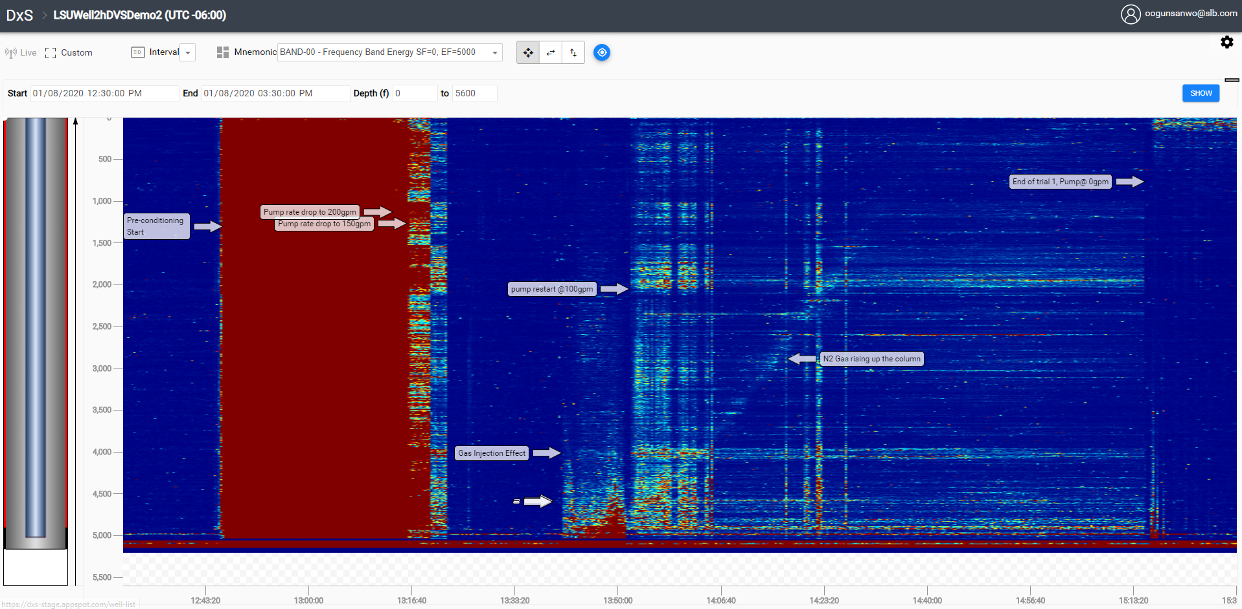
LSU: Gas Kick Test, Day 1, Trial 1: Real Time hDVS (DAS) Monitoring Quick Look
Trial 1 Conditions
Day | 1
Trial | 1
Flowrate [GPM] | 100
Kick [BBL] | 2
Gas | N₂
Injection Method | Line
Backpressure [PSI] | 100
Time Budget [min] | <162
Gas rising

Slide 4
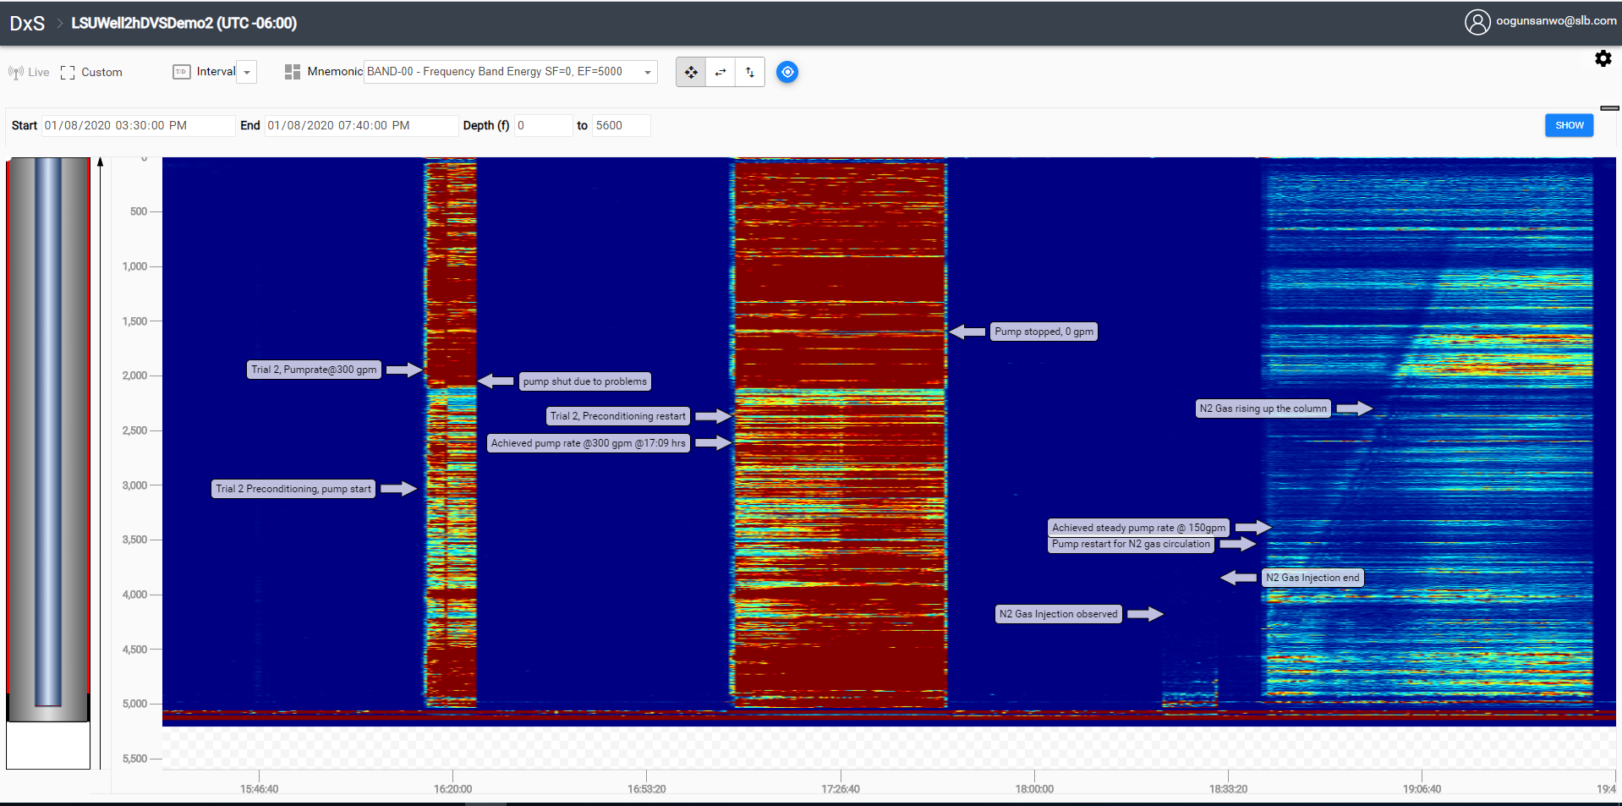
LSU: Gas Kick Test, Day 1, Trial 2: Real Time hDVS (DAS) Monitoring
Trial 2 Conditions
Day | 1
Trial | 2
Flowrate [GPM] | 150
Kick [BBL] | 2
Gas | N₂
Injection Method | Line
Backpressure [PSI] | 100
Time Budget [min] | <110

Slide 5
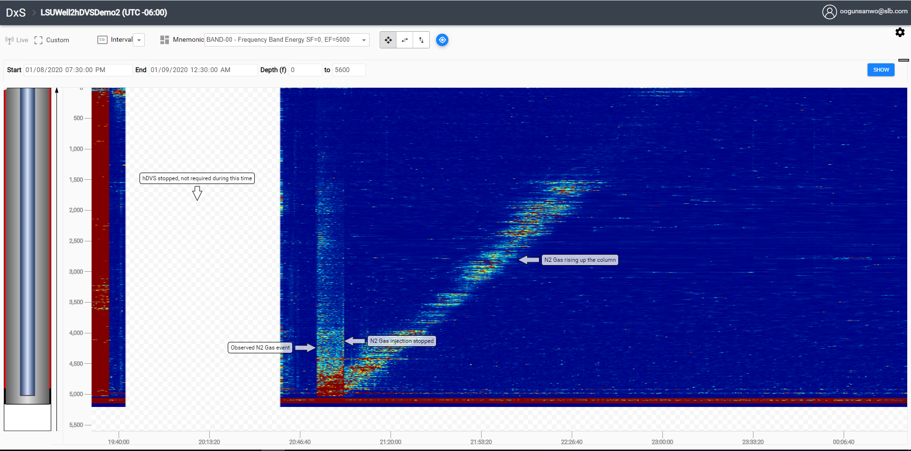
LSU: Gas Kick Test, Day 1, Trial 3: Real Time hDVS (DAS) Monitoring
Trial 3 Conditions
Day | 1
Trial | 3
Flowrate [GPM] | 0
Kick [BBL] | 2
Gas | N₂
Injection Method | Line
Backpressure [PSI] | Closed
Time Budget [min] | Overnight

Slide 6
Day 2, Trial 4, 9 & Overnight Static Trial Test Events Sequence
 | Events | Date | Start time (hrs) | Stop time (hrs) | Duration (hrs) | Comments
 | LSU Test Day 2, Jan 09, 2020
4 | Trial 4
 | Preconditioning Pump start-up | 8-Jan-20 | 9:08 | 9:55 | 0:47
 | Pump achieved steady rate @ 225 gpm | 8-Jan-20 | 9:55 | 10:30 | 0:35
 | Pump stopped to address pump system | 8-Jan-20 | 10:30 | 11:30 | 1:00
 | Prapare for Gas Injection | 8-Jan-20 | 11:30 | 11:44 | 0:14
 | Pump achieved steady rate @ 50 gpm | 9-Jan-20 | 11:44 | 11:49 | 0:05
 | Pump stop | 9-Jan-20 | 11:49 | 12:16 | 0:27
 | City water into Tubing-Casing Annulus (TCA) annulus | 9-Jan-20 | 12:16 | 13:05 | 0:49 | Multiple attempts to clear the gas (12:16 - 13:05 hrs)
 | Finished several attempts to clear N2 gas from casing | 9-Jan-20 | 13:05 | 13:15 | 0:10 | Successful
 | N2 Gas injection start (5.0 bbl) - Test Start | 9-Jan-20 | 13:15 | 13:39 | 0:24
 | N2 Gas injection end | 9-Jan-20 | 13:39 | 13:42 | 0:03
 | Pump re-start @ 100 gpm | 9-Jan-20 | 13:42 | 13:48 | 0:06
 | Pump achieved steady rate @ 100 gpm and applied 100 psi backpressure | 9-Jan-20 | 13:48 | 16:18 | 2:30
 | Open the casing choke | 9-Jan-20 | 16:18
 | End of trial 4 | 9-Jan-20 |  |  |  | End of trial 4
5 | 1st Bullhead Trial (#9), chase with 300 gpm down tubing, displace up tubing casing annulus @ 100 gpm , apply 200 psi back pressure
 | Preconditioning start & Pump trouble shooting to achieve desirable rate | 9-Jan-20 | 19:24 | 19:25 | 0:01 | Vibration, water hammer effect related issues
 | N2 Gas Bullheading through the tubing @ 7.0 bbl at the tubing top - start | 9-Jan-20 | 19:25 | 19:37 | 0:12 | Annular valve opened
 | N2 Gas Bullheading through the tubing @ 4.8 bbl - end | 9-Jan-20 | 19:37 | 19:48 | 0:11 | closed the annulus after 5.0 bbl of water in the tank.
 | Achieve 1550 psi casing pressure on the gas | 9-Jan-20 | 19:48 | 20:05 | 0:17 | Gauge #4 (5024'), BHP @ 2750 psi, 2800 psi @19:43 hrs, @2850 psi @ 19:44hrs; 2900 psi@ 19:45 hrs; 2950 psi @ 19:45 hrs; 3000 psi @ 19:45 hrs; 3050 psi @ 19:46 hrs; 3100 psi @ 19:47hrs;
 | Pump re-start for circulation @ 300 gpm | 9-Jan-20 | 20:05 | 20:09 | 0:04
 | Achieve pump rate @ 300 gpm | 9-Jan-20 | 20:09 | 20:13 | 0:04
 | Reduced pump rate to 100 gpm and applied 200 psi back pressure | 9-Jan-20 | 20:13 | 20:25 | 0:12
 | Final stabilization of flow conditions and monitor flow | 9-Jan-20 | 20:25 | 22:24 | 1:59
 | End of trial 9 | 9-Jan-20 | 22:24 |  |  | end of trial 9
7 | 2nd Bullhead Trial (left overnight), chase with 100 gpm down tubing, displace up tubing casing annulus @ 100 gpm , apply 200 psi back pressure
 | N2 Gas Bullheading through the tubing @ 7.0 bbl at the tubing top - start | 9-Jan-20 | 23:00 | 23:22 | 0:22 | Annular valve opened
 | N2 Gas Bullheading through the tubing @ 4.8 bbl - end @ the bottom of tubing | 9-Jan-20 | 23:22 | 23:25 | 0:03 | closed the annulus after 5.0 bbl of water in the tank.
 | Pump re-start for circulation @ 120 gpm | 9-Jan-20 | 23:25 | 23:37 | 0:12
 | Kill pump (0 gpm) and close choke | 9-Jan-20 | 23:37 | 23:38 | 0:01
 | Well left overnight for N2 gas rising up the well column | 9-Jan-20 | 23:38 | 5:00 | 5:22
 | End of trial | 10-Jan-20 | 5:00 |  |  | end of trial

Slide 7
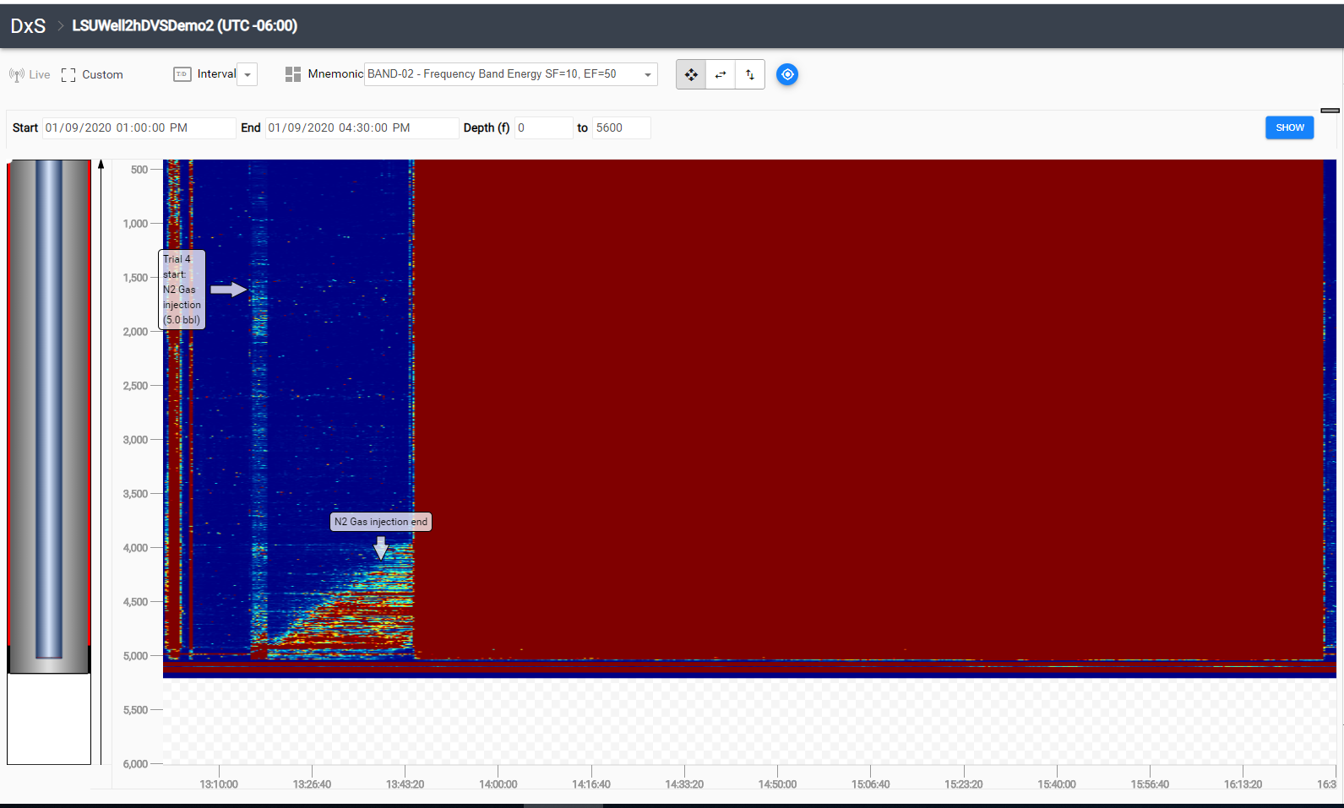
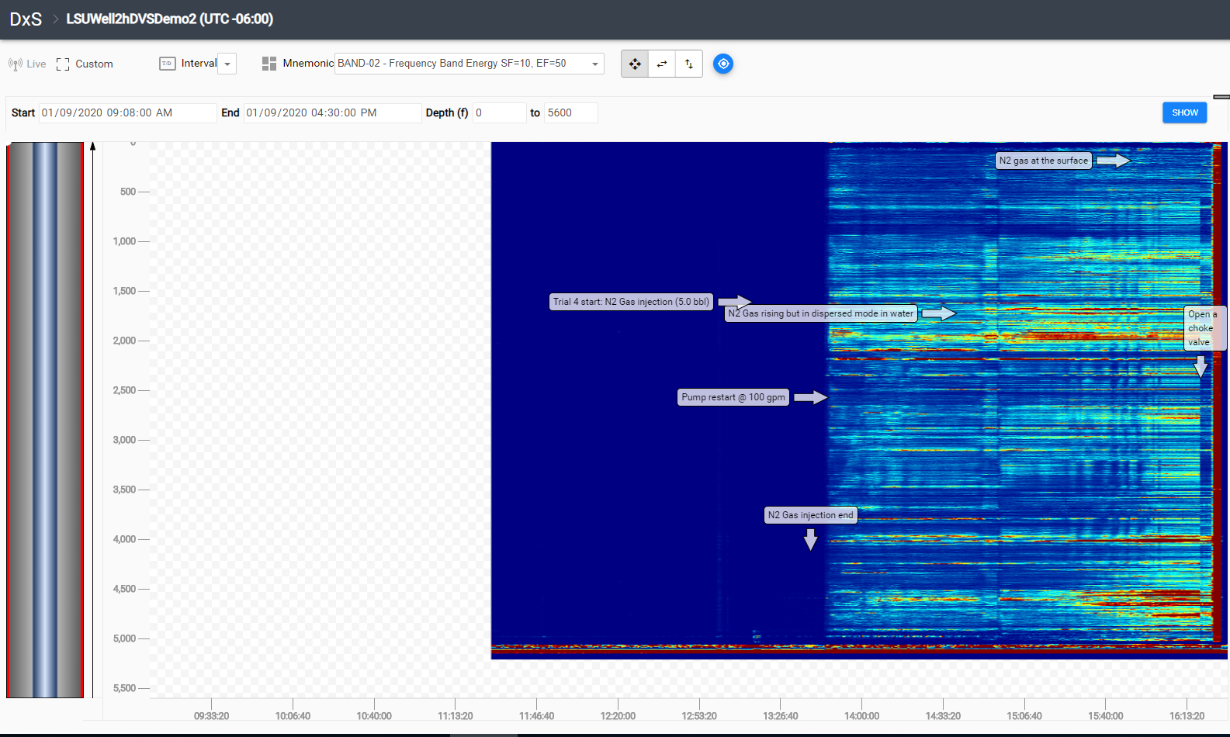
LSU: Gas Kick Test, Day 2, Trial 4: Real Time hDVS (DAS) Monitoring
Showing N2 gas injection through injection line
~5.0 bbl N gas kick at the bottomhole spread over a 1000 ft, recirculated @ 100 gpm while N2 gas rising up the column
Trial 9 Conditions
Day | 2
Trial | 4
Flowrate [GPM] | 100
Kick [BBL] | 5
Gas | N₂
Injection Method | Line
Backpressure [PSI] | 100
Time Budget [min] | 162
No hDVS (DAS) data recording

Slide 8
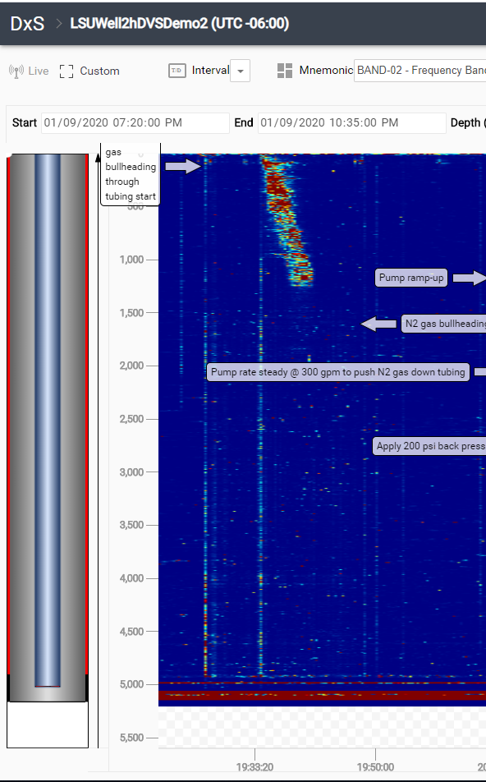
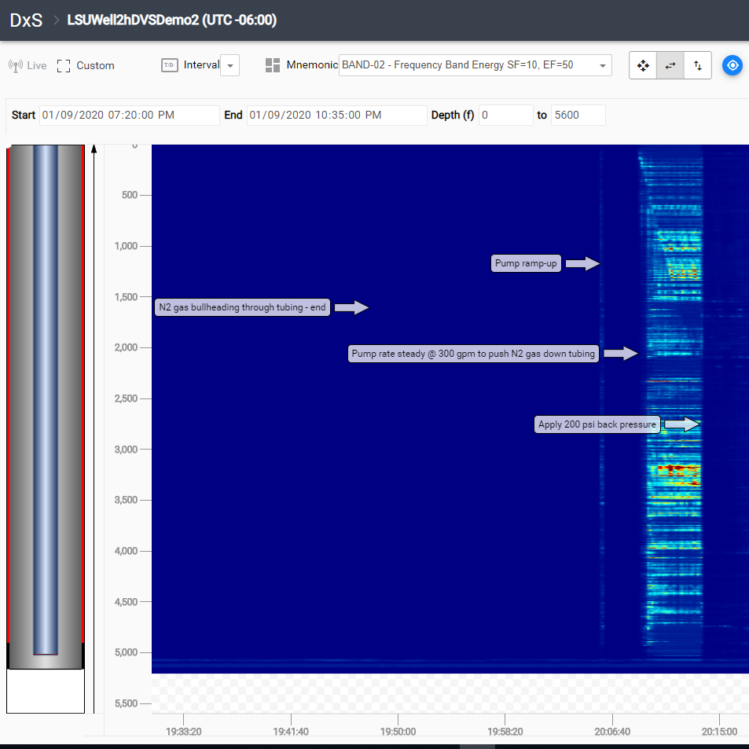
LSU: Gas Kick Test, Day 2, Trial 9: Real Time hDVS (DAS) Monitoring
Showing N2 gas bullheading
Showing pump @ 300gpm to push down the gas to deliver a kick
Trial 9 Conditions
Day | 2
Trial | 9
Flowrate [GPM] | 100
Kick [BBL] | 5
Gas | N₂
Injection Method | Bull
Backpressure [PSI] | 200
Time Budget [min] | 162

Slide 9
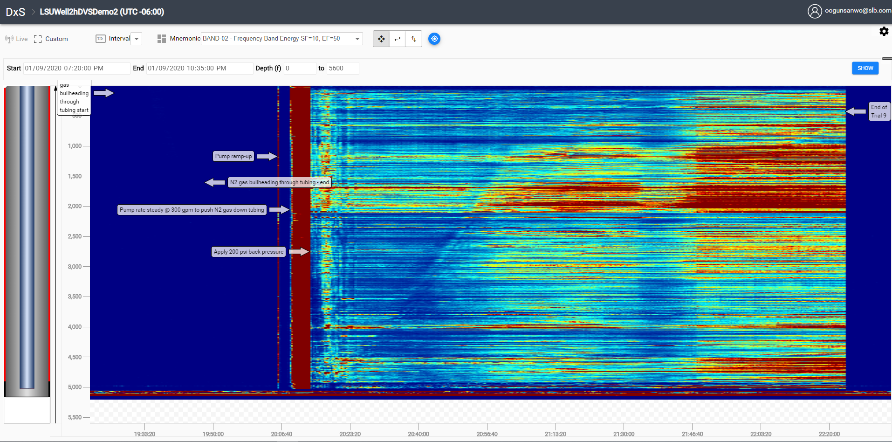
LSU: Gas Kick Test, Day 2, Trial 9: Real Time hDVS (DAS) Monitoring
Bull head N2 gas through tubing to achieve ~5.0 bbl gas kick at the bottomhole with recirculation @ 100 gpm while N2 gas rising up the column
Trial 9 Conditions
Day | 2
Trial | 9
Flowrate [GPM] | 100
Kick [BBL] | 5
Gas | N₂
Injection Method | Bull
Backpressure [PSI] | 200
Time Budget [min] | 162
N2 gas arrival
N2 gas rising

Slide 10
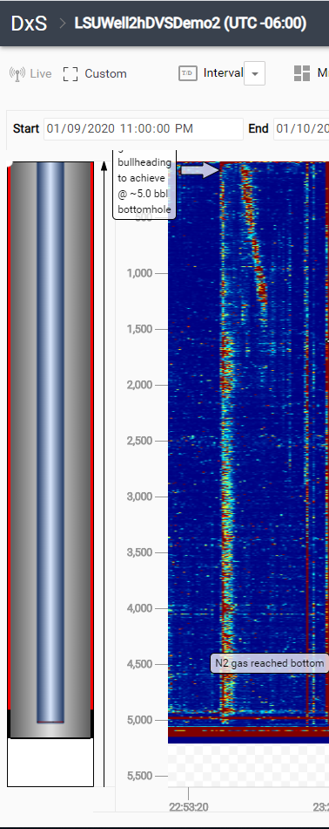
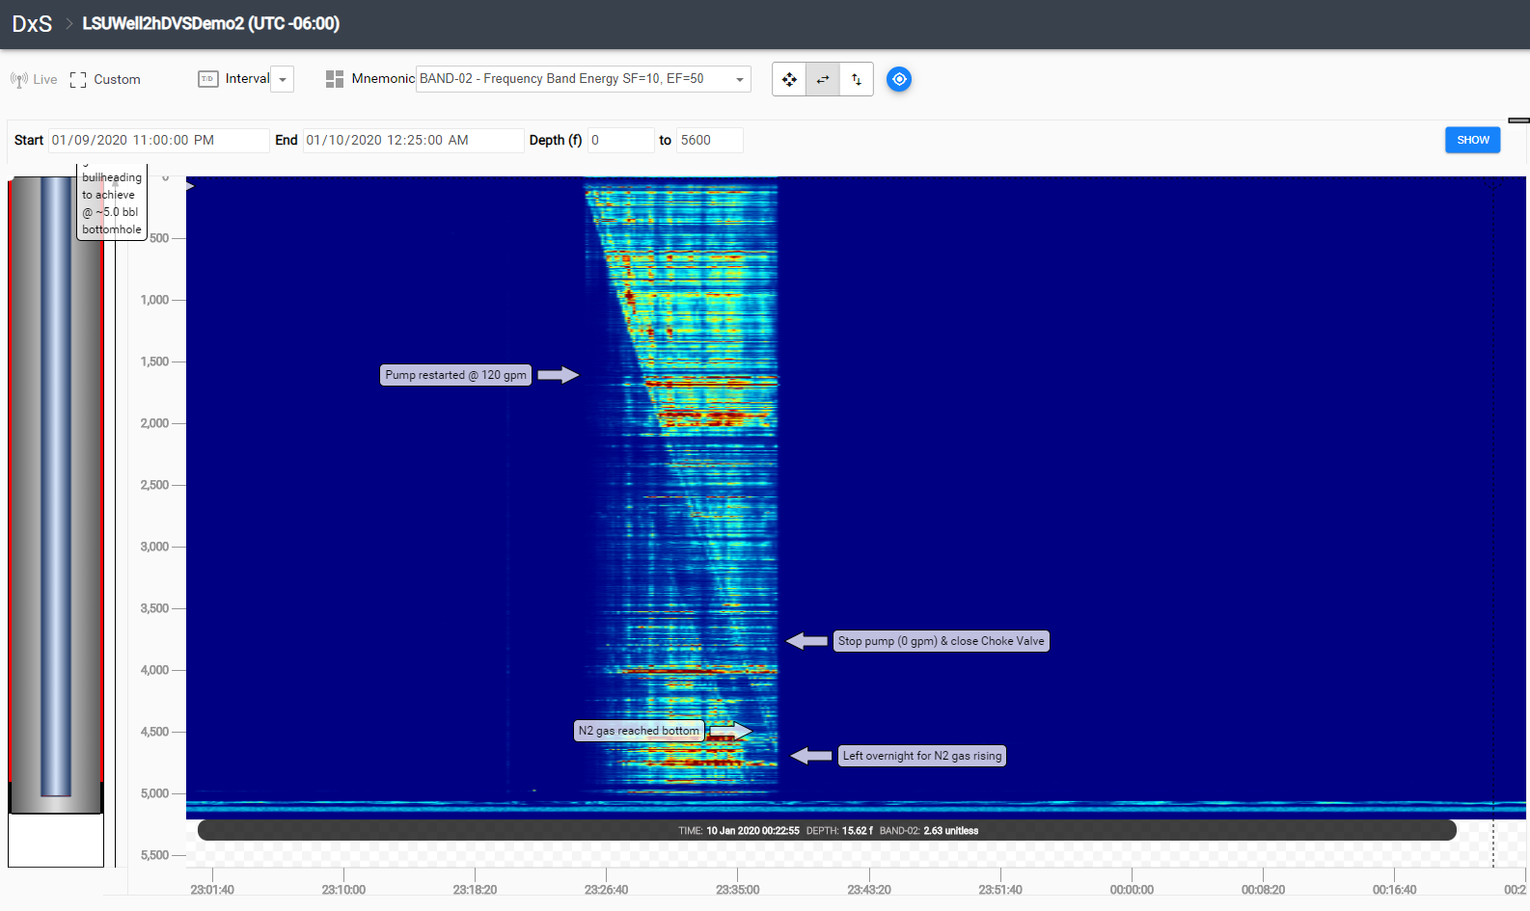
LSU: Gas Kick Test, Day 2, Overnight Static Test: Real Time hDVS (DAS) Monitoring
Showing N2 gas bullheading
Showing pump @ 120 gpm to push down N2 gas to deliver a kick at the bottomhole
Day 2 Overnight Trial Conditions
Day | 2
Trial | 9
Flowrate [GPM] | 100
Kick [BBL] | 5
Gas | N₂
Injection Method | Bull
Backpressure [PSI] | 200
Time Budget [min] | 162

Slide 11
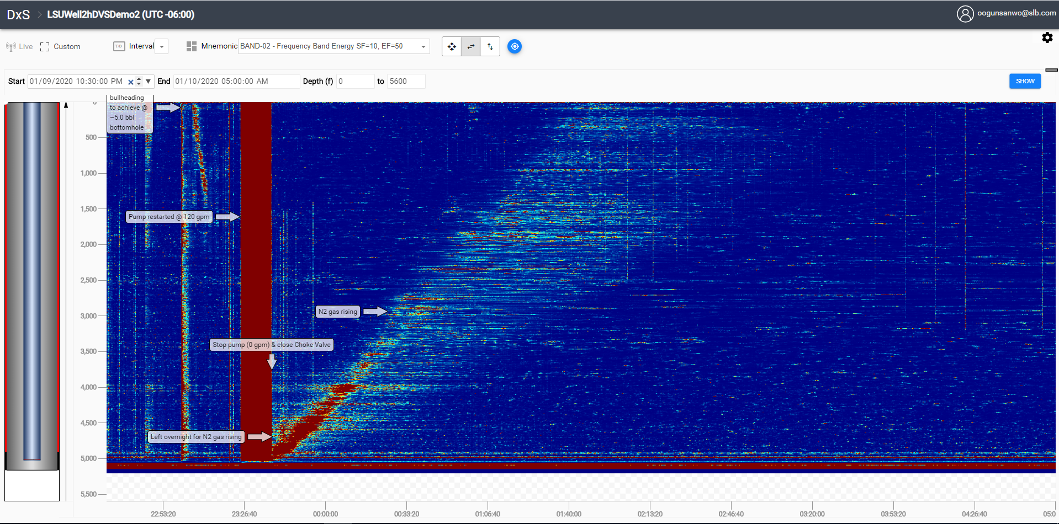
LSU: Gas Kick Test, Day 2, Overnight Trial : Real Time hDVS (DAS) Monitoring
Bullhead N2 gas through tubing to achieve ~5.0 bbl gas kick at the bottomhole, stop pump (0 gpm) and left overnight
Day 2 Overnight Trial Conditions
Day | 2
Trial | 9
Flowrate [GPM] | 100
Kick [BBL] | 5
Gas | N₂
Injection Method | Bull
Backpressure [PSI] | 200
Time Budget [min] | 162
Gas dispersion
Notes:
Time to reach surface: 03: 37 am, Jan 10th

Slide 12
Day 3, 3rd Bullhead Trial Test Events Sequence
 | Events | Date | Start time (hrs) | Stop time (hrs) | Duration (hrs) | Comments
 | LSU Test Day 3, Jan 10, 2020
4 | 3rd Bullhead Trial, chase with 100 gpm down tubing, displace up tubing casing annulus @ 100 gpm , apply 300 psi back pressure
 | Preconditioning start, pump rate went up to 420 gpm for 10mins | 10-Jan-20 | 9:52 | 10:26 | 0:34
 | N2 Gas Bullheading through the tubing @ 7.0 bbl at the tubing top - start | 10-Jan-20 | 10:26 | 10:37 | 0:11 | Annular valve opened
 | N2 Gas Bullheading through the tubing @ 5.0 bbl - stop | 10-Jan-20 | 10:37 | 10:45 | 0:08 | closed the annulus after 5.0 bbl of water in the tank
 | Achieve 1550 psi pressure on the gas with water | 10-Jan-20 | 10:45 | 10:48 | 0:03
 | Pump re-start for circulation @ 100 gpm and applied 300 psi back pressure | 10-Jan-20 | 10:48 | 10:55 | 0:07
 | Final stabilization of flow conditions and monitor flow | 10-Jan-20 | 10:55 | 13:17 | 2:22
 | End of trial | 10-Jan-20 | 13:17 |  |  | End of trial

Slide 13
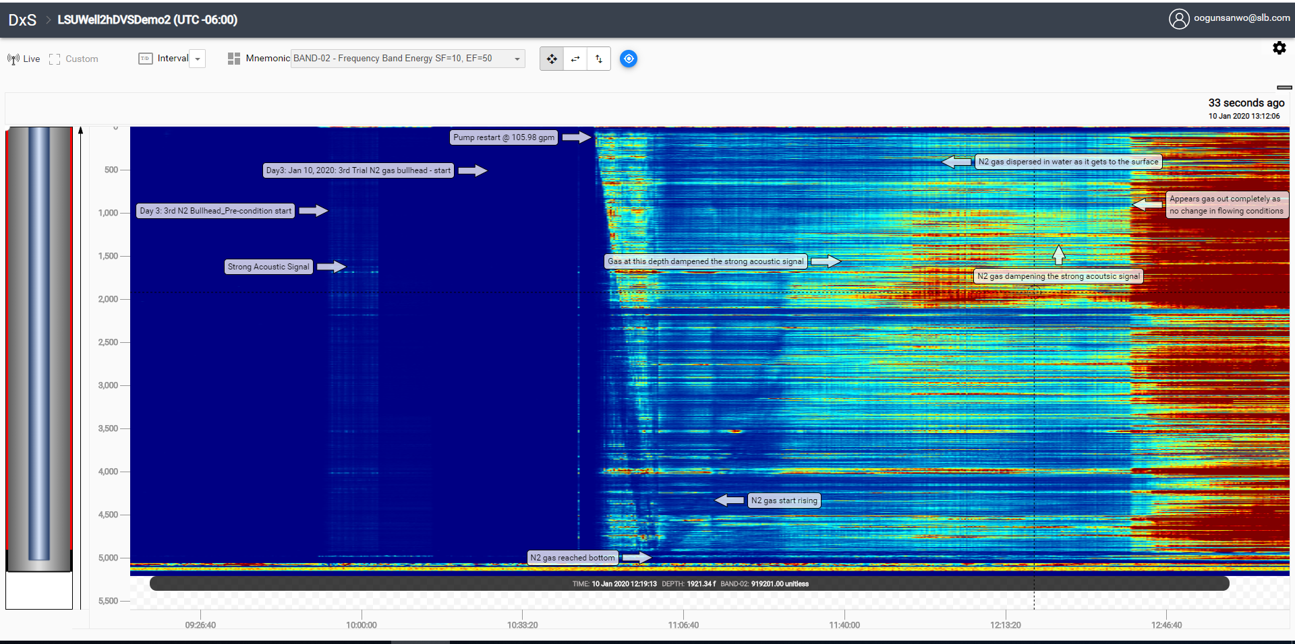
LSU: Gas Kick Test, Day 3, 3rd Bullhead Trial : Real Time hDVS (DAS) Monitoring
Trial 9 Conditions
Day | 3
Trial | 3rd Bullhead
Flowrate [GPM] | 100
Kick [BBL] | 5
Gas | N₂
Injection Method | Bull
Backpressure [PSI] | 300
Time Budget [min] | 162
Gas going down tubing

